Slide 1

GMR Institute of Technology, Rajam
Virtual Assistants using Natural Language Processing Techniques
Project Supervisor
Mrs.K.Santoshi
Assistant Professor
Department of IT
G.Rushivardhan(20341A1226)
8-Nov-22
1
8-Nov-22
1

Slide 2
ABSTRACT
A Virtual Assistant is software that can have Natural Language Conversations with people. The modelling of dialogue is one of the key tasks in Artificial Intelligence, Voice Recognization and Natural Language Processing. Making a good Virtual Assistant has been the most difficult challenge since the advent of Artificial Intelligence. Although Voice Assistants are capable of a variety of activities, their main responsibility is to recognize human speech and react properly. There are still some issues with developing data-driven systems despite the fact that there are now many Voice Assistant platforms available because a substantial amount of data is needed for their creation. Consequently, implementing these Virtual Assistants with Python libraries(like NLTK, spaCy, Polyglot, Text Blob, Flair) may be Accomplished. Moreover, to provide a better platform, Web Connectivity is also can be done to evaluate the Voice Assistant on a Web-based platform which will help in analyzing Human Voice Assistant Interactions.
Keywords: Virtual Assistant, Artificial Intelligence, Natural Language Processing, Python libraries, Voice Recognization , Speech Synthesizer

Slide 3
INTRODUCTION
Natural Language Processing refers to the branch of Computer Science-and more specially , the branch of AI-concerned with giving computers the ability to understand text and spoken words in much the same way human beings can. NLP helps developers to organize the tasks such as Translation, Automatic Summarization, Named entity Recognition, Speech Recognition[2]. NLP helps computers to communicate with humans in their languages . It is very time efficient. Most of the companies use NLP to improve the efficiency of documentation processes and identify the information from large databases. Voice Assistants are devices/apps that use voice recognition technology, Natural Language Processing, and AI to respond to humans[5]. Using the technology, the device synthesizes the user’s message, breaks it down, evaluates it, and offers a meaningful response in return . There are two categories of AI voice assistants: one is general-purpose, and the other is the bot voice assistants. Voice Assistant brands such as Siri and Alexa belong to the first category. Conversely, Voice Chatbots are usually the second type where the assistant is integrated into an app/website to help its users navigate the service. A Voice Assistant, also called an Intelligent Personal Assistant, are new types of products marketed by Apple, Amazon and Google and are based on natural language speech recognition. They allow a search to be carried out using a voice command entered by the user, as well as information retrieval by voice synthesis.

Slide 4
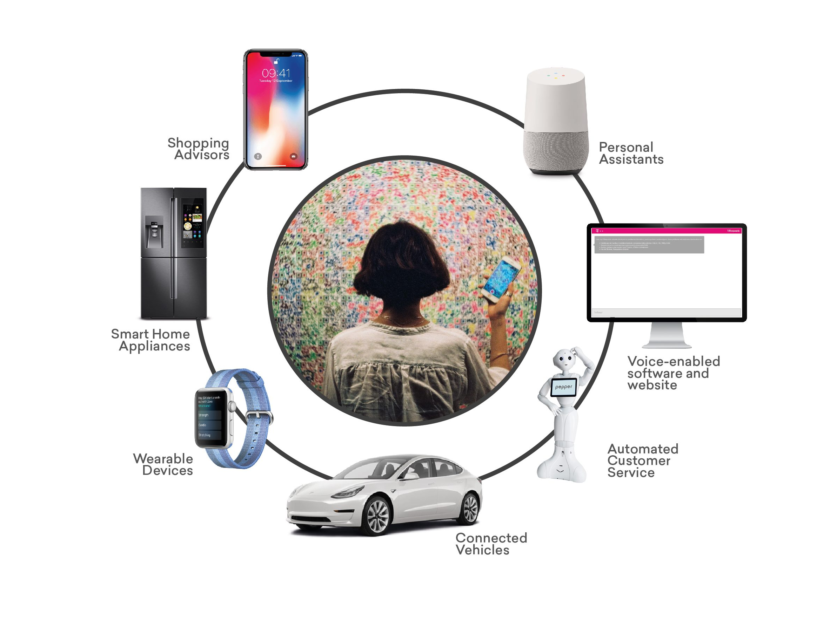
INTRODUCTION
Virtual Assistants emphasise with the conversation.
We can have access to computers, mobiles and many devices without slightly on your couch.
These voice assistants pull answers to voice queries.
The main advantage is these Virtual Assistants are saving time and effort

Slide 5
LITERATURE SURVEY-1
[1] Ritik Porwal ; Ujjawal Tomar ; Vishakha Dubey ; Asst.Prof.Akshita Mishra ; Asst.Prof.Gourav Mandloi “Voice Assistant” 2021 International Journal of Scientific Research & Engineering Trends(ISSN)
This paper mainly focuses on the most efficient way for Voice Recognition.
Microsoft Speech Synthesizer is used for the speech synthesis which consists of STT (Speech to text), sound or voice receive from user is converted to text for processing of information and gives us respective output through a voice assistance.
It Continues to expand its digital abilities in organizing several events like playing music , guiding services for travelling(Google maps) , game prediction.
The efficiency is High as the time consumption for each task to complete may be higher than the other VPAs.[Future Scope]

Slide 6
LITERATURE SURVEY-2
[2] Abhay Dekate ; Rohan Killedar ; “Study of Voice Controlled Personal Assistant Device”
2019 International Journal of Emerging Trends & Technology in Computer Science
The study on Home Automation system based on Internet of Things was proven to work satisfactorily by connecting simple appliances(like lights, fans Etc..)
It always keep listening for its Name and Wakes up to response upon calling with the assigned functionality.
Firstly , Sentence given or receive is passed to NLP and after that NLP core engine process these sentences and it is moved forward to speech synthesizer to respond.
The system will make human life more comfortable.

Slide 7
LITERATURE SURVEY-3
[3] Laura Burbach ; Patrick Halbach ; Nils Plettenberg ; Johannes Nakayama ; Martina Ziefle; Amdre Calero Valdez ; “ Hey, Siri; Ok Google; Alexa ; Acceptance-relevant factors of Virtual Voice-assistants” Published:2019 Digital Society Research Program
This Paper has investigated on the effect of natural language processing performance, price and privacy on acceptance of virtual voice assistants.
It also explains about the usage of Python’s NLTK library, TextBlob and spaCy library in making the Virtual Assistants more better.
Hence, Now a days privacy turned out as important aspect for the acceptance of voice assistants[Future Scope]

Slide 8

LITERATURE SURVEY-4
[4] Bayu Setiaji, Ferry Wahyu Wibowo , Department of Informatics Engineering STMIK AMIKOM Yogyakarta, Yogyakarta "Chatbot Using A Knowledge in Database-Humanto-Machine Conversation Modeling". 2016 IEEE
This paper explains the sentence similarity measurement so that it easy to find difference between two sentences or strings.
It tells about the probability of calculating a sentence that could be probably represented as equation.

Slide 9
LITERATURE SURVEY-5
[5] George Terzopoulos;Maya Satratzemi, “Voice Assistants and Artificial Intelligence in Education”, in Department of applied informatics on 26 September,2019
In this , Word Order Similarity Between Sentences is explained and tells the importance of Word order Similarity in Building a Virtual Assistant.
Porter stemming algorithm is used here for building a chat bot for College Management system , where Porter Stemming Algorithm is a process for removing suffixes from words in English.

Slide 10
METHODOLOGY-1
Speech Synthesizer Algorithm:
1. NLP Core Engine process the input given by the user so that it can be sent to the speech synthesizer to respond.
2. Microsoft Speech Synthesizer is used which consists of STT.
STT is speech to text, it sound or voice receive from user is converted to text
for processing of information by bot.
Then its responds according to the input given by the user.

Slide 11
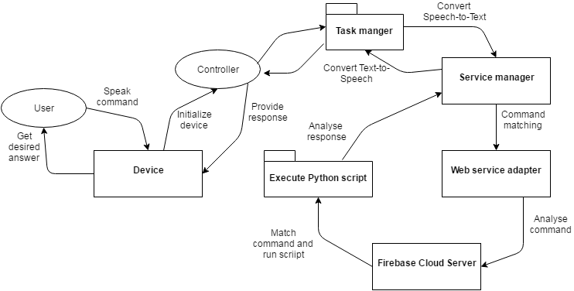
METHODOLOGY-2
Steps involved in Data Flow Sequence Algorithm:
Initialize device
Task Manager
Service Manager : Analyses the commands and matches them with servers
Execute Command : When the matching found for commands , run the py script and gives response

Slide 12
METHODOLOGY-3
The Virtual Assistant consists of core and interface accessing that core. The core is in RDBMS being database.
The database consists of tables to store knowledge, while the interpreter is a stored program of function and procedure sets for requiring of pattern matching.
The interface could be a standalone application that can be employed by user for chatting or conversation. It can also be employed by service that needs additional client application to converse with the user.
This application in the interface side can be expanded more over as user needs it and can also be written using other programming languages.

Slide 13
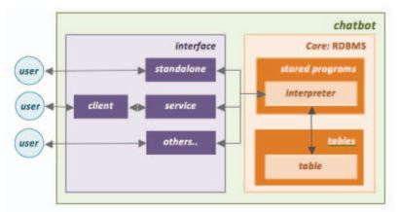
METHODOLOGY-3
This Virtual Assistant consists of core and interface accessing that core. The core is in RDBMS being database

Slide 14
METHODOLOGY-4
Porter stemming algorithm (or 'Porter stemmer') is a process for removing suffixes from words in English. Removing suffixes automatically is an operation which is especially useful in the field of information retrieval.
Following are the steps of this algorithm:-
[1]Gets rid of plurals and -ed or -ing suffixes
[2]Turns terminal y to i.
[3]Maps double suffixes to single ones: -ization, -ational, etc.
[4]Deals with suffixes, -full, -ness etc. Takes off -ant, -ence, etc.
Removes a final –e

Slide 15
RESULTS AND DISCUSSIONS
1.Voice enabled bot:
The chatter bot performed up to the marked as in case of text provided, results produce were 97.3 percent accurate and more reliable. But in case of voice enabled input due difference in accent of user and Microsoft speech synthesizer model whose accent is based on UK or USA users. Thus, result obtain were close to the appropriate answer. Thus, from above it can be consider that speech synthesizer need to be model for all kinds of accent such that it process the voice input more correctly, therefore chatter bot model can produce more accurate results.

Slide 16
RESULTS AND DISCUSSIONS
2.A Personal Assistant Voice Assistant
It Keeps learning the sequence of questions asked to it related to its context which it remembers for the future. So, when the same context is mentioned ,it starts a conversation with you asking the relevant questions.
It performs the Arithmetic Calculations based on voice commands and giving back the computer solution through the voice. Search Internet based on user voice input and giving back the reply through a Voice Assistance. Results produced were 98 percent accurate to the input.

Slide 17
RESULTS AND DISCUSSIONS
3. Virtual Chat Bot using database-human to machine:
In making a table of database for chatbot, it had implemented a forward-engineering technique. This technique is generating Entity Relationship (ER) into DDL scripts those could be executed as table generating. All designs of tables and stored programs had been implemented in the RDBMS MySQL. Before testing process was done, it ought to be entered some knowledge which input sentence patterns stored in the pattern table and response sentences stored in the template table. Results produced were 93.2% accurate to the input.In additional it had to be entered mapping as representation of relationship between both pattern and template stored in the pattern template table.

Slide 18
RESULTS AND DISCUSSIONS
4.Virtual Assistants for Education:
It is a virtual assistant to provide services regarding course activities such as record session data and services related to attendance, task assignment and scoring management. The user just has to register himself to the system and has to login to the system. The Virtual Assistance consists of core and interface that is accessing the core in (MySQL). Results produced were 79.6 percent accurate to the input. Natural language processing technologies are used for parsing, tokenizing, stemming and filtering the content of the complaint.

Slide 19
CONCLUSION
Among The Four individual Reference papers which is done about “Virtual Assistance Using NLP Techniques. After considering the different algorithms are used. Comparative study performed among the various techniques like speech synthesizer, data flow sequence, core and interface accessing, porter stemming. After the Analysis based on the accuracy on the above-mentioned table. The Data Flow Sequence Algorithm has most accuracy for providing the required output as required for the user.
S.no | Model | Accuracy %
1 | Speech Synthesizer | 97.3
2 | Data Flow Sequence | 98
3 | Core and interface Accessing | 93.2
4 | Porter Stemming | 79.6

Slide 20
REFERENCES
[1] Ritik Porwal ; Ujjawal Tomar ; Vishakha Dubey ; Asst.Prof.Akshita Mishra ; Asst.Prof.Gourav Mandloi “Voice Assistant” 2021 International Journal of Scientific Research & Engineering Trends(ISSN)
[2] Abhay Dekate ; Rohan Killedar ; “Study of Voice Controlled Personal Assistant Device” 2019 International Journal of Emerging Trends & Technology in Computer Science
[3] Laura Burbach ; Patrick Halbach ; Nils Plettenberg ; Johannes Nakayama ; Martina Ziefle; Amdre Calero Valdez ; “Hey,Siri;Ok,Google;Alexa:Acceptance-relevant factors of Virtual Voice-assistants” Published:2019 Digital Society Research Program
[4] Bayu Setiaji, Ferry Wahyu Wibowo , Department of Informatics Engineering STMIK AMIKOM Yogyakarta, Yogyakarta "Chatbot Using A Knowledge in Database-Humanto-Machine Conversation Modeling". 2016 IEEE
[5] George Terzopoulos;Maya Satratzemi, “Voice Assistants and Artificial Intelligence in Education”, in Department of applied informatics on 26 September,2019

Slide 21


